Slide 1
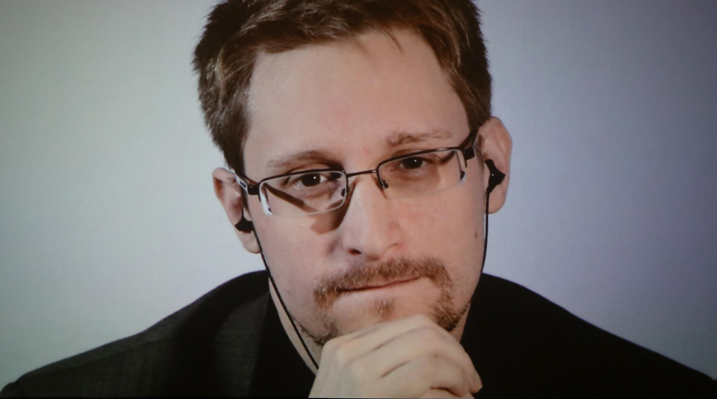
Edward Snowden
by Maksim and Ilya

Slide 2

Early years
was born in 1983 in Elizabeth City, North Carolina.
In tenth grade stopped attending high school.
began taking classes at the local community college and became engrossed in computers
In 2004 joined the United States Army Reserve

Slide 3

Cybersecurity career
Snowden’s career as a security specialist began in 2005
In 2006, he was hired by the CIA in Langley, Virginia.
In 2009, he resigned from the CIA to work as a private contractor: first for Dell, then for Booz Allen Hamilton

Slide 4

Stealing NSA documents
While working at the NSA office in Hawaii in 2013, Snowden grew increasingly disturbed by how the NSA was spying on ordinary citizens through their phone and internet data.
On May 20, 2013, Snowden flew to Hong Kong and braced himself for what was to come

Slide 5

Leaks to the press
On June 5, 2013, The Guardian leaked documents demonstrating that Verizon was sharing all of its user data with the NSA.

Slide 6

Aftermath
On June 9, 2013, Snowden revealed his identity through The Guardian, stating, “I have no intention of hiding who I am because I know I have done nothing wrong.”
Several days later U.S federal prosecutors charged Snowden.
He has remained in Russia, where he was initially granted temporary asylum, and later a residency permit

Slide 7

Conclusion

